Slide 1
Journal Club August 2019 William R. Toth, Lt Col USAF MC

Slide 2
The Article
JOURNAL:
Influence of simulation on electronic health record use patterns among pediatric residents
Authors:
Evan W Orenstein, Irit R Rasooly, Mark V Mai, Adam C Dziorny, Wanczyk Phillips, Levon Utidjian, Anthony Luberti, Jill Posner, Rebecca Tenney-Soeiro, and Chris P Bonafide
Published:
Journal of the American medical Informatics Association
25 (11) 21 August 2018
doi: 10.1093/jamia/ocy105

Slide 3
The Article

Slide 4
Abstract
Objective: Assess the effect simulation has on EHR use patterns
Methods: Simulated admission for pediatric interns and monitored EHR audit logs
Results: increased utilization of data visualization tool and information retrieval tool
Discussion: Simulation was associated with persistent changes to EHR use in pediatric residents
Conclusion: EHR simulation is an effective educational method for changing real life clinical use

Slide 5
Background
Average training consists of < 3 days
Most common learning through passive means
Classroom
Rote Scripts
Online e-learning
Shadowing

Slide 6
Background
EHR use is cognitively complex
Inadequate utilization (not using tools)
Inappropriate utilization (haphazard navigation)
Even “clinical expert” routinely miss safety concerns in simulations
EHR simulation
Recognized as training modality
Improves subsequent error recognition
Requires substantial resources
Unproven effect on real-life
Notes:
inadequate utilization – patient safety issues
inappropriate utilization– trial and error use to ordering in CPOE -> increases dosing errors

Slide 7
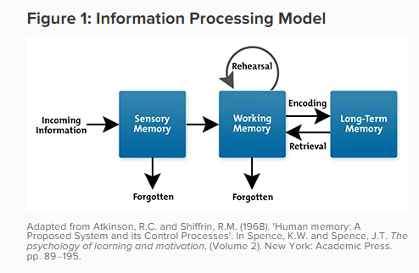
Cognitive Load Theory
Types of Cognitive Load
Intrinsic
Extraneous
Germane
Cognitive load and errors
Notes:
John Sweller (1980s)
intended to assist in the presentation of information in a manner that encourages learner activities that optimize intellectual performance
Intrinsic - inherent level of difficulty associated with a specific instructional topic
Extraneous - generated by the manner in which information is presented to learners. attributed to the design of the instructional materials.
Germane - processing, construction and automation of schemas.
Heavy cognitive load typically creates error in the task at hand. Also creates stereotyping in an effort to reduce cognitive load
Using working memory instead of adding additional incoming information is imperative
Reduce problem space (gap between the “now” and the “desired goal”)
Reduce the split-attention effect (multiple pieces of information at once)

Slide 8
Methods
Pediatrics Department at Children’s Hospital of Philadelphia
Untreated control group
Intervention group
Pre-intervention
Post Intervention
Inpatient service EHR utilization was obtained during all three periods

Slide 9
Educational intervention
Simulation Curriculum aimed as first-year pediatric residents
Focused on patient safety concerns
One a month, 1-hour teaching of 4-6 interns
Aim of increasing awareness of ED handoffs
Simulation
Interns given 12 minutes to review the chart
Verbally make a plan for oncoming resident
Followed by debrief

Slide 10
Generation Effect
Remember information better when taking an active part in producing it, rather than having it provided by an external source
Explains the role of active over passive learning
Requires that the learner actively generates the product that is used in the teaching
Participants actively generate EMR data
Data is reviewed for learning process in debrief
Other opportunities for use:
Generate questions and answers over read material
Make flashcards
Fill in the blank/short answer materials
Notes:
DeWinstanley, P. A., & Bjork, E. L. (2004). Processing strategies and the generation effect: Implications for making a better reader. Memory & cognition, 32(6), 945-955.

Slide 11
Educational intervention
Simulated case:
Hyperbilirubinemia
Exploration beyond the note revealed:
Instability suggestive of neonatal sepsis
Evidence of hemolytic anemia
Debrief:
Emphasized aspects of EHR
Specific data visualization tools
Vital signs trends
Medication administration
Lab values
Nursing observations
Information retrieval activities
Phrase finder
Searches notes, labs orders, problems
Notes:
tools were chosen based on informal discussions with local clinical informaticians and patient safety experts who felt based on clinical experience that increased use of these tools might improve trainees’ efficiency and ability to detect safety concerns. However, no empiric evaluation was performed to assess their impact on provider or patient outcomes
Both tools were part of native functionality in Epic SystemsVC versions 2014 and 2015 and had been introduced to all pediatric residents during their EHR orientation just prior to the start of their first year
Simulations were conducted in a training environment that refreshed every night from a master training environment where the original simulated patient was built. Each refresh created 10 copies, such that each simulation participant worked on his/her own patient, and an unused patient was used for the debrief session.

Slide 12
EHR Use Patterns
Correlation between simulation and
Use of data visualization tool
Use of information retrieval tool
Number of resident clicks per week
Mixed effect logistical regression
Time-series analysis with segmented regression
Immediate
Long-term

Slide 13
Results
139 Residents
57 interns participated in EHR simulation
Mean of 21 weeks into their residency
4,311 resident-weeks evaluated
2650 weeks of control
612 weeks pre-simulation in intervention
1049 weeks post-simulation in intervention

Slide 14
Results
Data Visualization tool
47% pre-simulation
73% post-simulation
Odds Ratio 5.83
Information Retrieval tool
36% pre-simulation
85% post-simulation
Odds Ratio 10.47
Notes:
residents completed a median of 28 weeks per year of residency, the contribution of completed inpatient weeks
“completed inpatient weeks” increased use of both tools
Odds Ratio 6.07 for visualization
Odds Ratio 15.22 for information retrieval

Slide 15
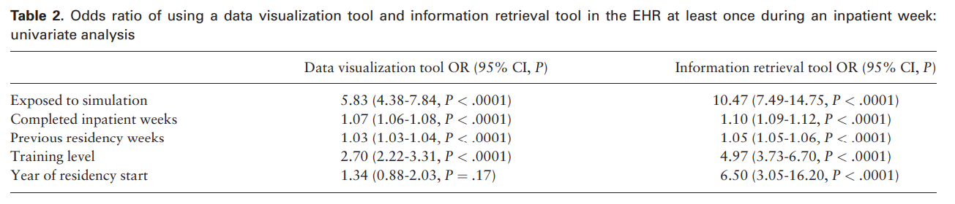
Results
Notes:
residents completed a median of 28 weeks per year of residency, the contribution of completed inpatient weeks
“completed inpatient weeks” increased use of both tools
Odds Ratio 6.07 for visualization
Odds Ratio 15.22 for information retrieval

Slide 16
Results
Use of tool 5 times in a week:
Increased 2.66-fold for data visualization
Increased 6.17-fold for information retrieval
Use of tool 10 times in a week:
Increased 3.29-fold for data visualization
Increased 4.78-fold for information retrieval
Over time:
Data visualization tool
absolute change of 21%
Slope -0.21 to 0.36 (+0.57)
Information retrieval tool
Absolute change 12%
Slope (0.94 to 0.23)-0.36
Notes:
residents completed a median of 28 weeks per year of residency, the contribution of completed inpatient weeks

Slide 17
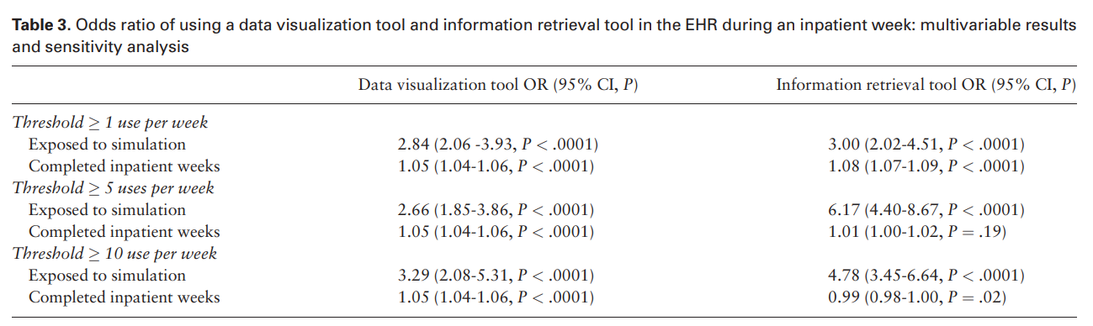
Results
Notes:
residents completed a median of 28 weeks per year of residency, the contribution of completed inpatient weeks

Slide 18
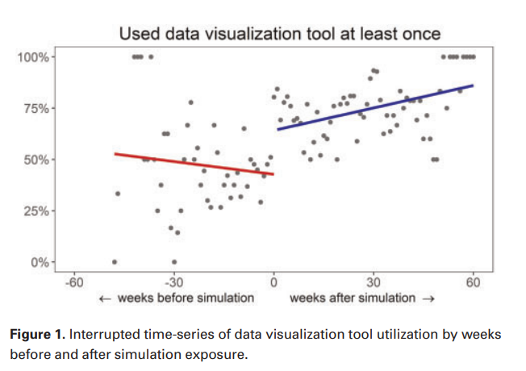
Results
Notes:
residents completed a median of 28 weeks per year of residency, the contribution of completed inpatient weeks

Slide 19
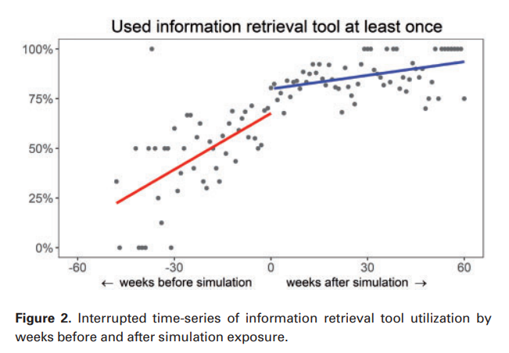
Results
Notes:
residents completed a median of 28 weeks per year of residency, the contribution of completed inpatient weeks

Slide 20
Discussion
Persistent changes in EHR utilization
EHR training with simulation can drive screen selection in EHR
Tool accessibility impacts usability
Data visualization tool must be added
Information retrieval tool defaults on home screen
Tool diffusion
Association with resident cohort
Information retrieval tool diffused more quickly
Training vs. variability in use of new tools
Notes:
residents completed a median of 28 weeks per year of residency, the contribution of completed inpatient weeks

Slide 21
Discussion
EHR simulation learning to clinical practice
Mohan et al.
Replicate real-world conditions
Simulate cognitive load
Often practiced in a “training environment”
Static
Reformatted
Simplified
Not accurate reflection of the actual EHR
Notes:
Mohan V, Scholl G, Gold JA. Intelligent simulation model to facilitate EHR training. Am Med Inform Assoc 2015; 925–32. http://www.ncbi. nlm.nih.gov/pmc/articles/PMC4765600/. Accessed August 17, 2016.

Slide 22
Discussion
Germane load
Demand for resources towards learning the task
Extraneous load
Use mental resources for tasks unrelated to the learning objectives
Unrealistic scenario
Adaptation to unfamiliar environment

Slide 23
Limitations
Single residency program
Did not differentiate based on learners' skills
Did not compare other modalities
Lectures
Observations
One-on-one training

Slide 24

Discussion
Do you believe the intervention was effective in testing the hypothesis?
What made it effective?
What made it ineffective?
Based on this study, would you consider implementation of a similar project here?
Why or why not?
What barriers may exist to implementation?
Are there other modalities that may have more effectively trained towards the aims?
How may you apply cognitive load theory to future training?
How may you apply the generation effect to impart improved learning?
Notes:
“completed inpatient weeks” ??? (pg 1503)
Odds Ratio 6.07 for visualization
Odds Ratio 15.22 for information retrieval

Slide 26
The Role of Cognitive and Learning Theories in Supporting Successful EHR System Implementation Training:
43 interviews & 6 physician focus groups
7 best practices for implementation:
Obtain organizational commitment to invest in training
Assess users’ skills and training needs
Select appropriate training staff
Match training to users’ needs
Use multiple training approaches
Provide training support throughout implementation
Retrain and optimize
Notes:
the entire EHR implementation process was driven by strong leadership commitment and a vision toward transforming care and improving quality through effective use of the EHR
potential EHR users, mainly clinicians, did not have basic computer literacy and skills.
none of the sites we studied depended solely on IT experts to support their training function. There was widespread recognition among our informants that people prefer learning from similar others, particularly clinicians. largely favored using clinicians as trainers and/or superusers.
Different groups have unique perspectives and needs and developed training initiatives accordingly
Strong emphasis on hands-on learning, whether as part of a training session or during actual system implementation
users needed to first learn the basics of the EHR system, and then, after a period of active use, would be both ready and motivated to enhance their skills.

Slide 27
Successful Physician Training Program for Large Scale EMR Implementation:
Physician engagement/communication
Timing
Learning environment
Design considerations
Learner groups
Clinical relevance
Content delivery
Enforcing training requirements
Adult learning theory
Instructor Selection
Assessment and Proficiency
Recognition
Notes:
the entire EHR implementation process was driven by strong leadership commitment and a vision toward transforming care and improving quality through effective use of the EHR
potential EHR users, mainly clinicians, did not have basic computer literacy and skills.
none of the sites we studied depended solely on IT experts to support their training function. There was widespread recognition among our informants that people prefer learning from similar others, particularly clinicians. largely favored using clinicians as trainers and/or superusers.
Different groups have unique perspectives and needs and developed training initiatives accordingly
Strong emphasis on hands-on learning, whether as part of a training session or during actual system implementation
users needed to first learn the basics of the EHR system, and then, after a period of active use, would be both ready and motivated to enhance their skills.

